Slide 1
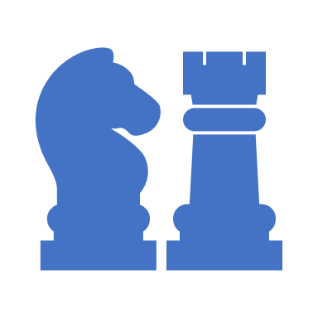
Chess Set
TinkerCAD

Slide 2
Schedule – to help you stay on track
April 26 - 30
Monday – Sketch Pawn & Bishop
Tuesday – Sketch Rook & Knight
Wed. - Sketch King & Queen
Thursday – Finishing Touches
Friday – Design Challenge
May 3 - 7
Monday – Model Pawn & Bishop
Tuesday – Model King & Queen
Wed. – Model Rook & Knight
Thursday – Chess Board Assembly
Friday – Design Challenge

Slide 3
Purposes of this project
To create and replicate custom components.
Assemble components to create a final technical drawing.
Design custom parts with a similar theme.
Draw on prior knowledge from the Recorder Project.

Slide 4
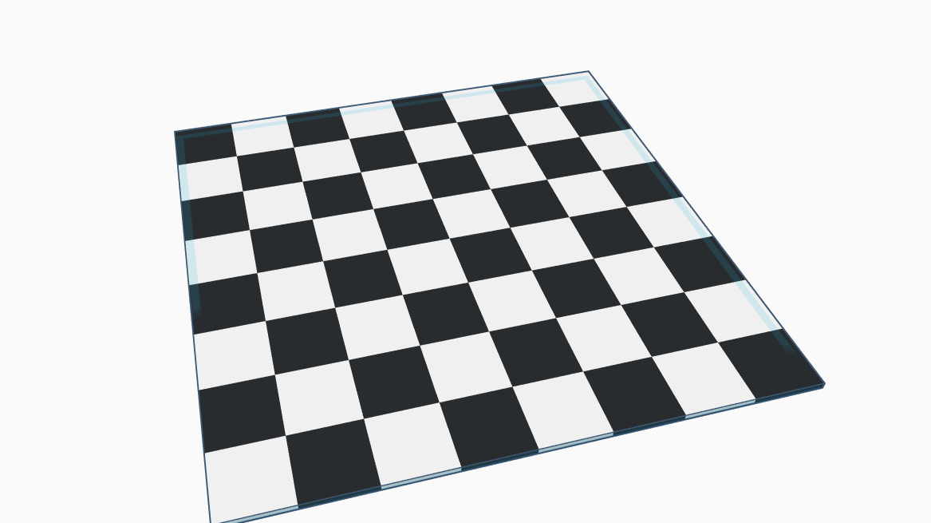
Game Board

Slide 5
Game Board Steps
Bring a box into the Workplane.
Size the box 25mm x 25mm x 2mm
Place the box just underneath the work plane
Place the ruler tool in the corner of the Workplane.
Zero-in your box to the corner where the ruler was placed.
Duplicate your box along the x-axis (x7)
Colour and Group the row of boxes.
Duplicate the group of boxes along the y-axis
Mirror every second row of boxes to make the checker board pattern.

Slide 6
Game Pieces
For this project, I will not be providing you with the steps to create the game pieces. Rather, I will be providing you with a set of parameters to follow.
Your game pieces should fit centered on each game tile.
Your game pieces should follow a theme (use google to draw inspo)
You’ll need to create 1 of each – Pawn, Rook, Knight, Bishop, Queen & King.
You should create a ‘New Project’ in TinkerCAD to organize your parts.
Use the images in the following slides to get an idea of assembly of each piece.

Slide 7
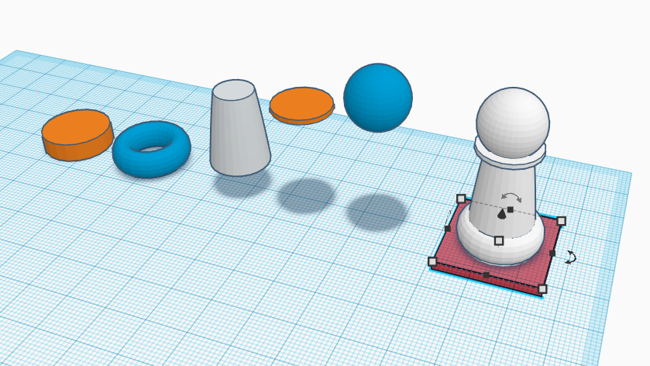
Pawn

Slide 8
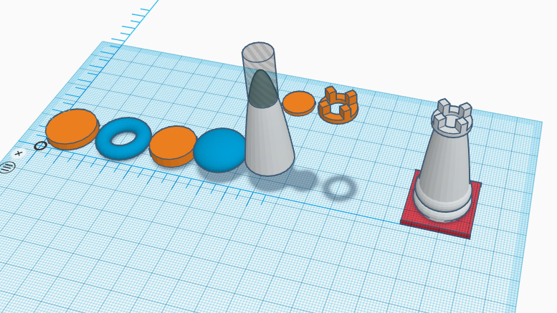
Rook / Castle

Slide 9
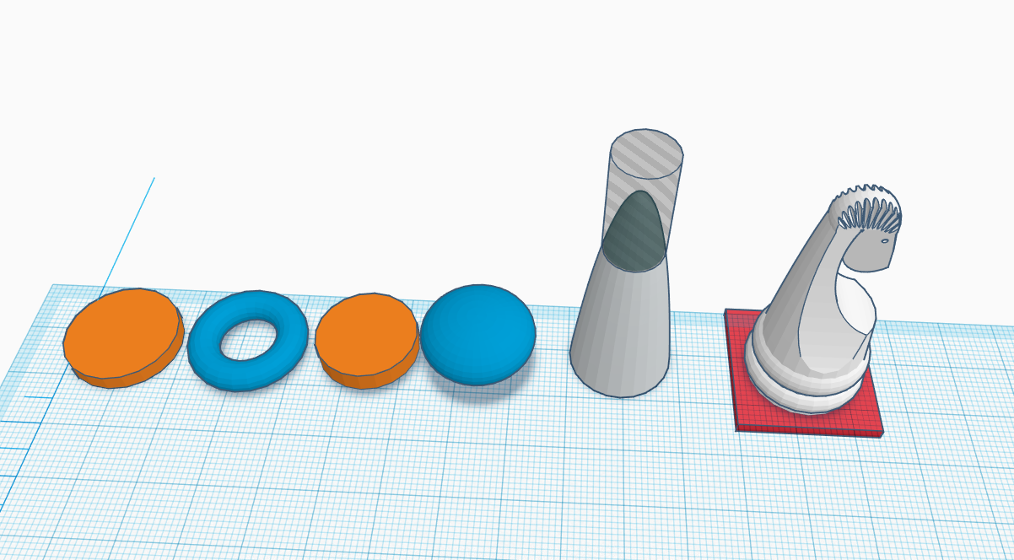
Knight

Slide 10
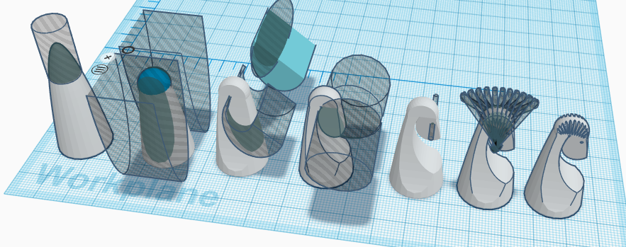
Knight (top)

Slide 11
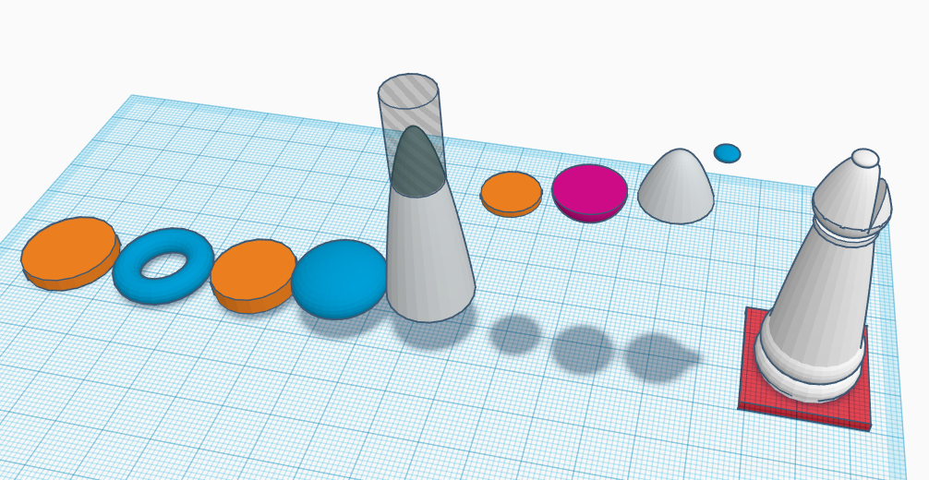
Bishop

Slide 12
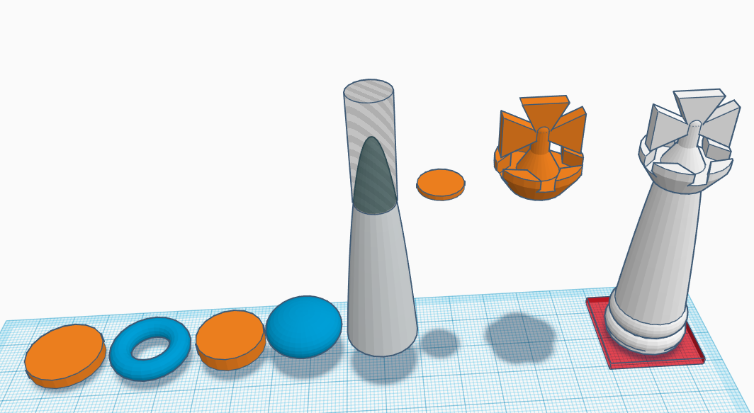
King

Slide 13
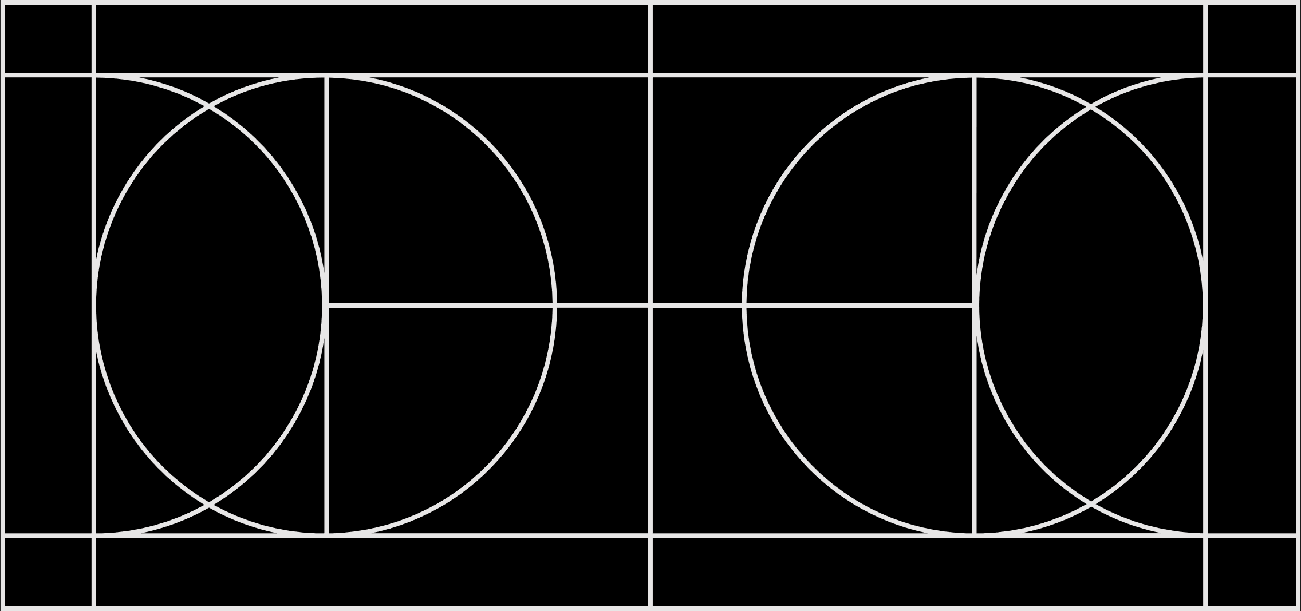
King (top)

Slide 14
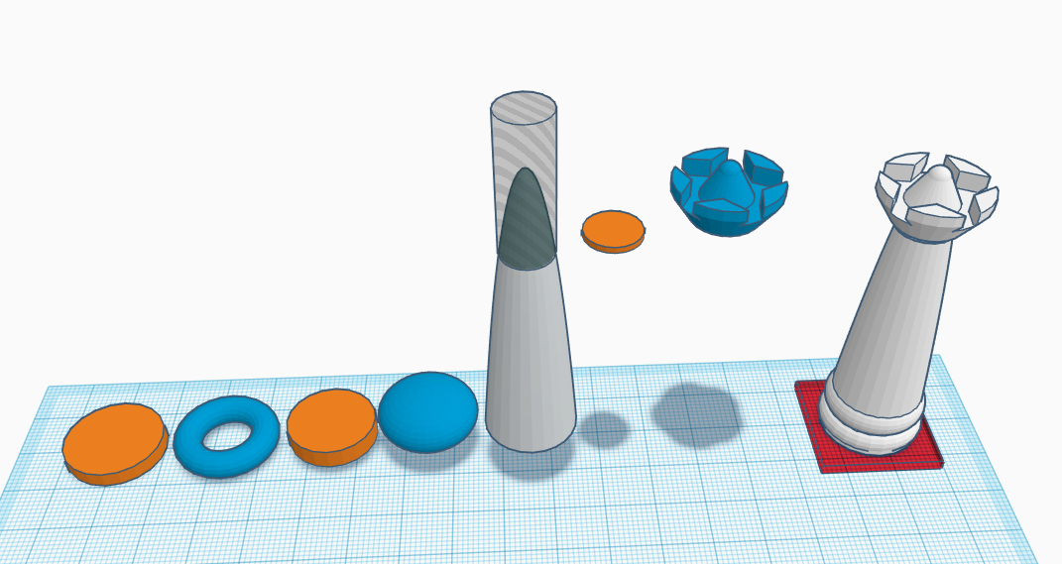
Queen

Slide 15
Queen (top)

Slide 16
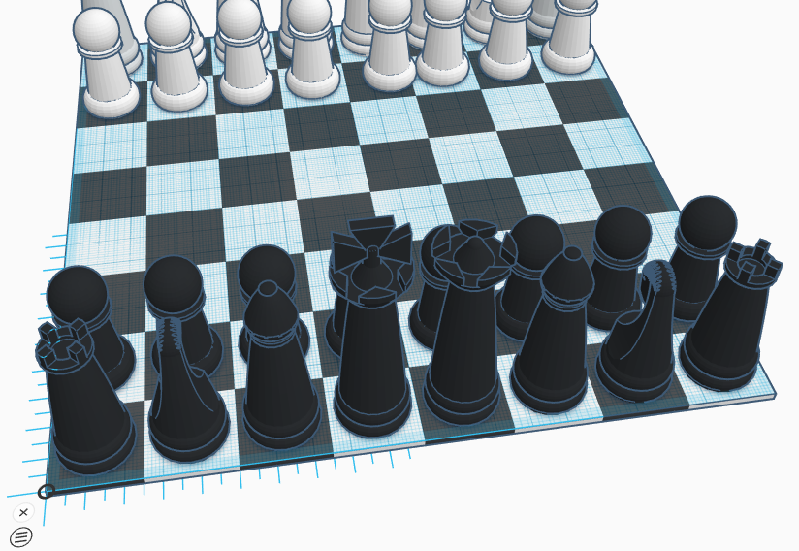
Assembly

Slide 17
Assignment Submission
Submit .stl file of assembled chess board to Teams.
Submit photos and/or scans of sketches for each piece.
Complete Project Reflection in Microsoft Forms.

